Slide 1

Human-Computer Interaction (HCI)
Mario Čagalj
University of Split
7.11.2012.

Slide 2
User Centered Design and Prototyping
Why user-centered design is important
Prototyping and user centered design
Prototyping methods

Slide 3
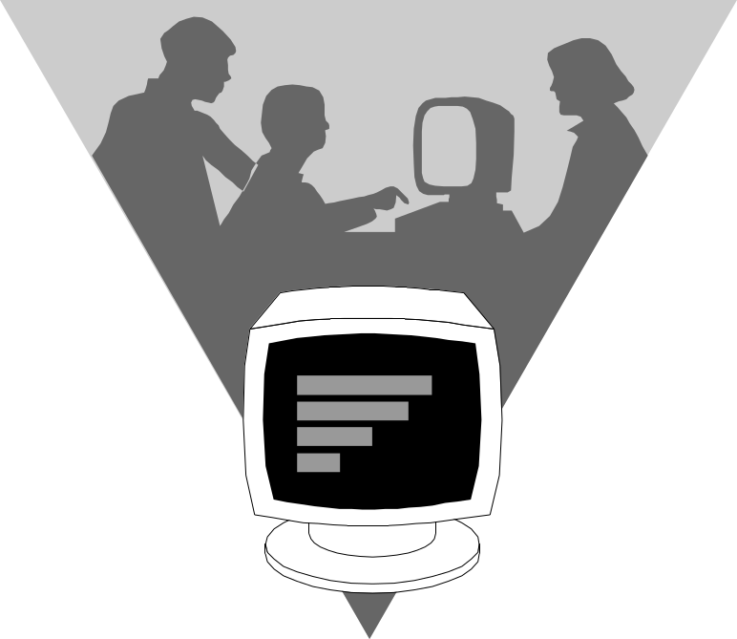
System Centered Design
What can I easily build on this platform?
What can I create from the available tools?
What do I as a programmer find interesting?

Slide 4
User Involvment is Central
In US 250 billion dollars is spent every year on 175 000 IT projects (2005)
365 IT companies with 8380 IT projects were analyzed in 1995 (CHAOS Report by Standish Group)
  31.1% of the projects were cancelled
  52.7% were performed with changing plans
  16.2% were performed according to a plan
  on average, the cost of changing plans increased with 189%
  81 billion dollars spent on projects that never leads to any results
Involving the user in all stages of the design cycle crucial
  Managers: “Takes too long and will increase timescales.”
  Your answer: “It is not about time, it is about allocating time differently, and usability should be seen as an investment not an expense”
http://usability.dlmu.edu.cn/sesun2-lecture/051019-Funda-User-Centered%20Systems%20Design_en.pdf

Slide 5

User Centered System Design
Design is based upon a user’s
  abilities and real needs
  context
  work
  tasks
  need for usable and useful product
End-users influence how a design takes shape
  at each stage of the design process
Golden rule of interface design: Know The User

Slide 6
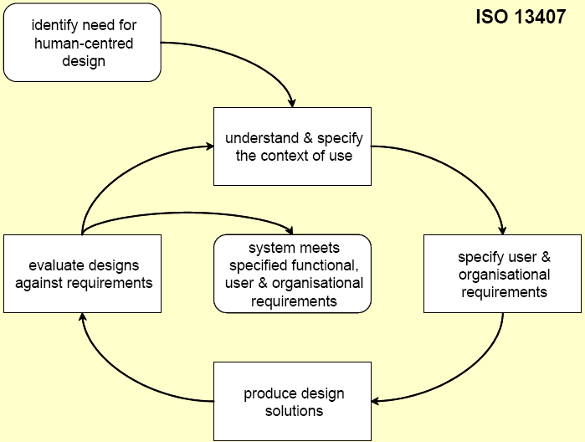
User Centered Design (UCD)
Note:
Google UCD
UCD is a philosophy and a process that place users at the centre of the product’s design and development life cycle (ISO 13407 standard)
Why do you need it?
  UCD can improve the usability and usefulness of everything
    from software to information systems to processes, anything with which people interact.
  UCD seeks to answer questions about users and their tasks and goals
    then use the findings to drive development and design.
http://www.uxconsulting.com.sg/services/user-centered-design-ucd-consultancy

Slide 7
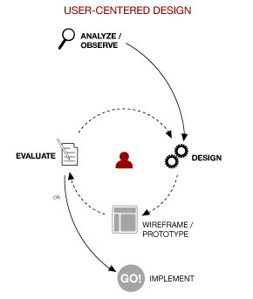
User Centered Design (UCD)
http://www.yucentrik.ca/en/expertise-2/tools/

Slide 8
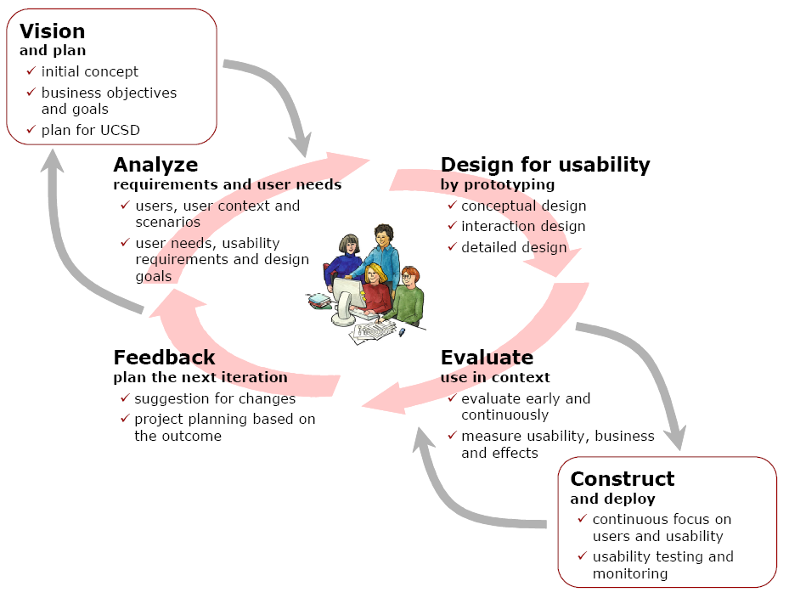
User Centered Design (UCD)
User-centred system design is a process focusing on usability throughout the entire development process and further throughout the system life cycle
http://www.it.uu.se/research/hci/acsd/KeyPrinciplesPoster-v.1.2en.pdf

Slide 9
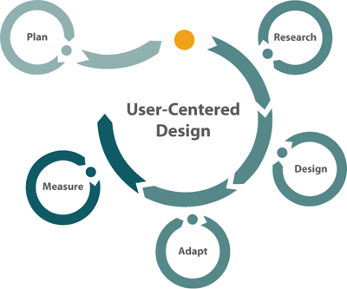
Example: SAP User Centered Design
http://www.sapdesignguild.org/resources/ucd_paper.asp
Plan
  identify the key stakeholders and collaborators
  hold interviews with key stakeholders
  identify UCD activities and determine budget
Research
  create user profiles based on research findings
  identify and understand goals, tasks, needs of the target users
  derive user requirements through data synthesis
Design
  create use cases and a user object model
  together these comprise the user's perspective or mental model of the system
  sketch potential UI design solutions
    early designs in the form of wireframes, with increasing in fidelity as the concepts become clearer.
  validate the design proposals with cognitive walkthroughs
Adapt
  limitations in the target technology, new requirements, or missing functionality
Measure
  when product released, it is possible to measure its usability quantitatively
  tests measure a product's effectiveness, efficiency, and satisfaction

Slide 10
Participatory Design
An approach to design attempting to actively involve all stakeholders (e.g. employees, partners, customers, citizens, end users) in the design process
  to help ensure the product designed meets their needs and is usable
Participants (putative, potential or future) are invited to cooperate with designers, researchers and developers during an innovation process
  they participate during several stages of an innovation process:
    they participate during the initial exploration and problem definition both to help define the problem and to focus ideas for solution,
    and during development, they help evaluate proposed solutions.
Emerged in Scandinavia
http://en.wikipedia.org/wiki/Participatory_design

Slide 11
Participatory Design is User-Design
Participatory design can be seen as a move of end-users into the world of researchers and developers
There is a very significant differentiation between user-design and user-centered design
  user-centered design suggests that users are taken as centers in the design process, consulting with users heavily, but not allowing users to make the decisions, nor empowering users with the tools that the experts use
Example: Wikipedia
  Wikipedia content is user-designed
    users are given the necessary tools to make their own entries
  Wikipedia's underlying wiki software is based on user-centered design:
    while users are allowed to propose changes or have input on the design, a smaller and more specialized group decide about features and system design.
http://en.wikipedia.org/wiki/Participatory_design

Slide 12
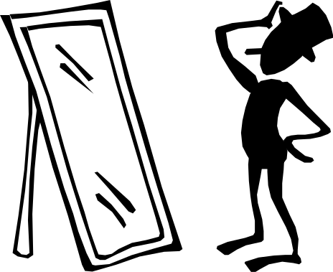
Participatory Design
Problem
  intuitions wrong
  interviews etc not precise
  designer cannot know the user sufficiently well to answer all issues that come up during the design
Solution
  Designers should have access to representative users
    END users, not their managers or union representatives!
The user is just
like me

Slide 13
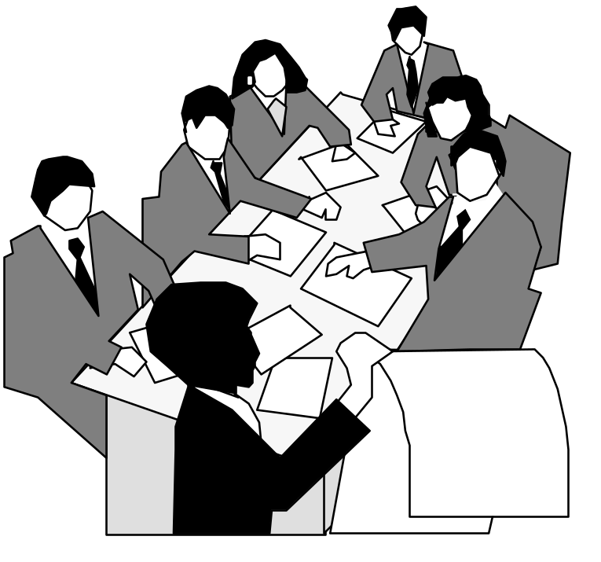
Participatory Design
Users are 1st class members in the design process
  active collaborators vs passive participants
Users considered subject matter experts
  know all about the work context
Iterative process
  all design stages subject to revision

Slide 14
Participatory Design
Up side
  users are excellent at reacting to suggested system designs
    designs must be concrete and visible
  users bring in important “folk” knowledge of work context
    knowledge may be otherwise inaccessible to design team
  greater buy-in for the system often results
Down side
  hard to get a good pool of end users
    expensive, reluctance ...
  users are not expert designers
    don’t expect them to come up with design ideas from scratch
  the user is not always right
    don’t expect them to know what they want

Slide 15
How to Involve Users in Design?

Slide 16
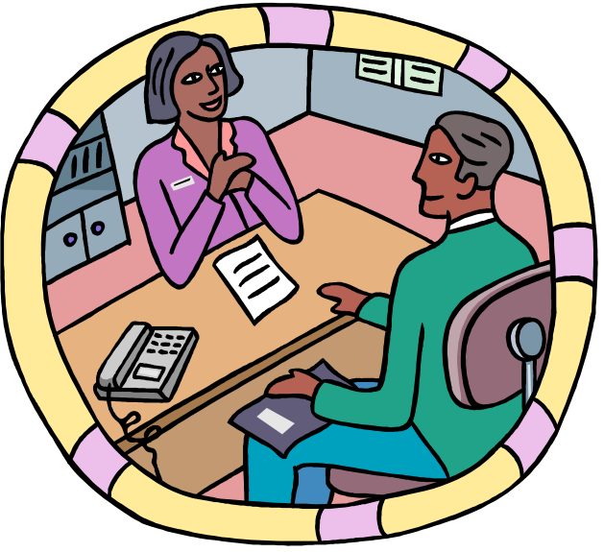
Methods for involving the user
At the very least, talk to users
  surprising how many designers don’t!
Contextual interviews + site visits
  interview users in their workplace, as they are doing their job
  discover user’s culture, requirements, expectations,…

Slide 17
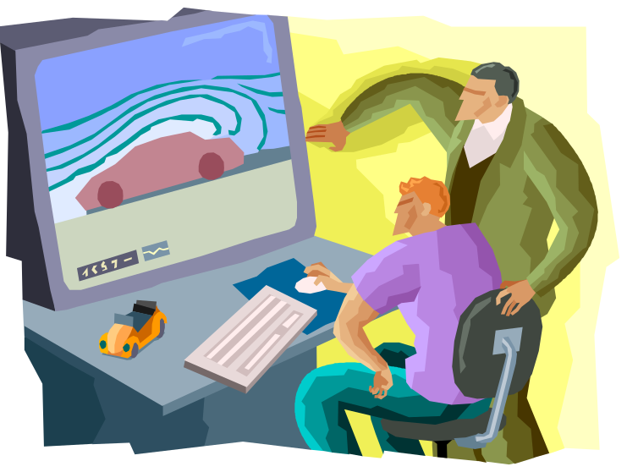
Methods for involving the user
Explain designs
  describe what you’re going to do
  get input at all design stages
    all designs subject to revision
Important to have visuals and/or demos
  people react far differently with verbal explanations
  this is why prototypes are critical

Slide 18
Why prototypes?
Get feedback earlier and cheaper
Experiment with alternatives
  to resolve a hard design decitions
Easier to change or throw away
  important not to commit strongly to design ideas
  creative freedom
  is this the case with 1k lines of code?

Slide 19
Prototype fidelity
How similar is it to the finished interface
Low fidelity
  omits details
High fidelity
  looks like finished product (could impede a tester)

Slide 20
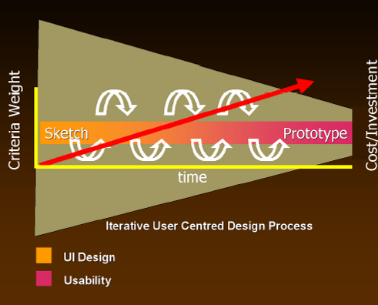
Sketching and Prototyping
Sketches / low / medium / high fidelity prototypes
  as investment in design increases (red arrow), so does the formality of the criteria whereby concepts are reviewed or accepted
From design to evaluation
  similarly, interface design
  (idea generation) progresses
  to usability testing (idea
  debugging and refinement)
From Design for the Wild, Bill Buxton (in press) with permission

Slide 21
Sketching and Prototyping
Early design
Brainstorm different representations
Choose a representation
Rough out interface style
Sketches & low fidelity paper prototypes
Task centered walkthrough and redesign
Fine tune interface, screen design
Heuristic evaluation and redesign
Usability testing and redesign
Medium fidelity prototypes
High fidelity prototypes
Working systems
Limited field testing
Alpha/Beta tests
Late design

Slide 22
Sketches & Low Fidelity Prototypes
Paper mock-up of the interface look, feel, functionality
  quick and cheap to prepare and modify
Purpose
  brainstorm competing representations
  elicit user reactions
  elicit user modifications / suggestions

Slide 23
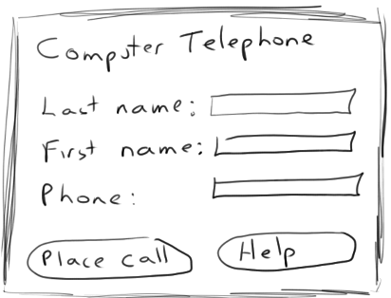
Sketches
  drawing of the outward appearance of the intended system
  crudity means people concentrate on high level concepts
  but hard to envision a dialog’s progression
Computer Telephone
Last Name:
First Name:
Phone:
Place Call
Help

Slide 24
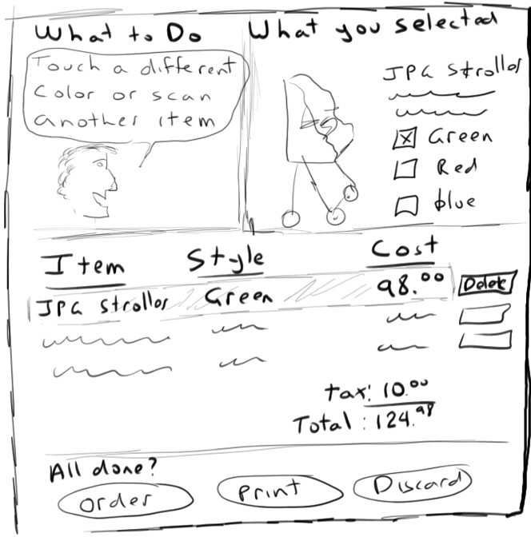

Slide 25
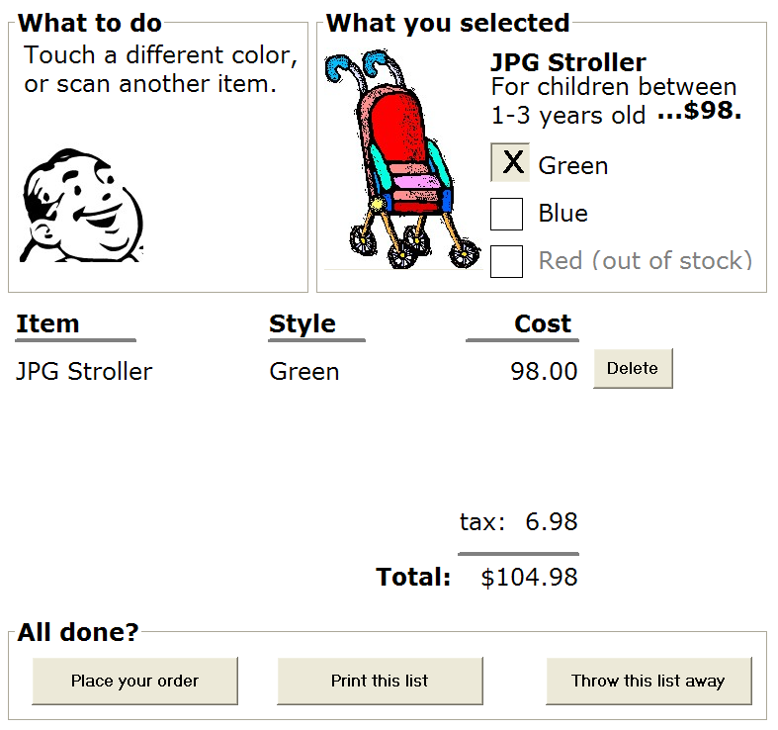

Slide 26
The attributes of sketches
Quick
  to make
Timely
  provided when needed
Disposable
  investment in the concept, not the execution
Plentiful
  they make sense in a collection or series of ideas
Clear vocabulary
  rendering & style indicates it’s a sketch, not an implementation
Constrained resolution
  doesn’t inhibit concept exploration
Consistency with state
  refinement of rendering matches the actual state of development of the concept
Suggest & explore rather than confirm
  value lies in suggesting and provoking what could be i.e., they are the catalyst to conversation and interaction
From Design for the Wild, Bill Buxton (in press) with permission

Slide 27
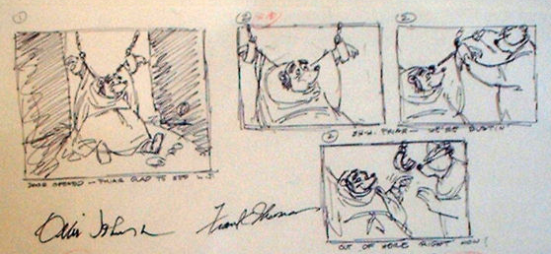
Storyboarding
Note:
Phone example
  a series of key frames as sketches
    originally from film; used to get the idea of a scene
    snapshots of the interface at particular points in the interaction
  users can evaluate quickly the direction the interface is heading
Excerpts from Disney’s Robin Hood storyboard, www.animaart.com/Cellar/disneyart/90robin%20storyboard.jpg.html

Slide 28
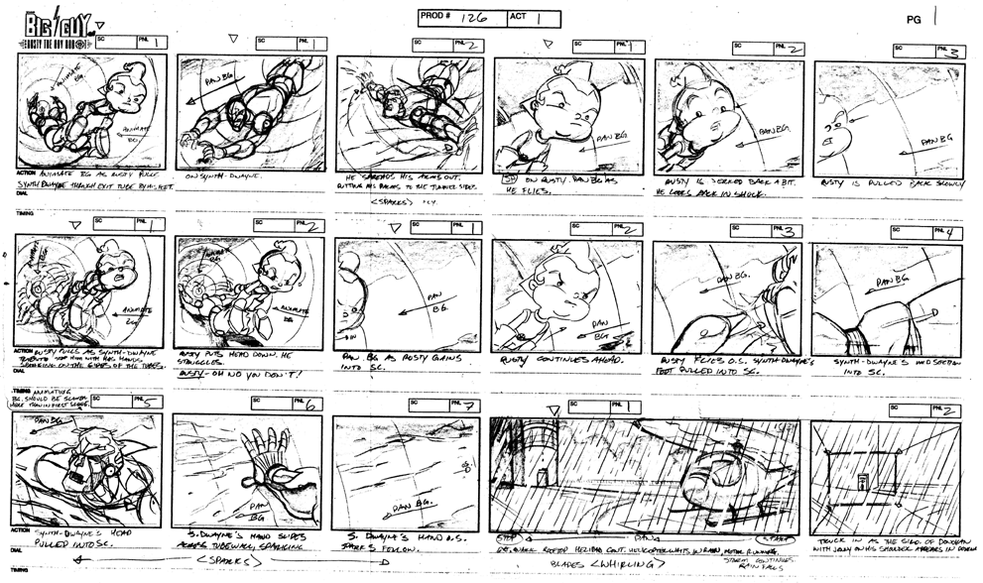
note how each scene in this storyboard is annotated
From www.michaelborkowski.com/storyboards/images/big_bigguy1.gif

Slide 29
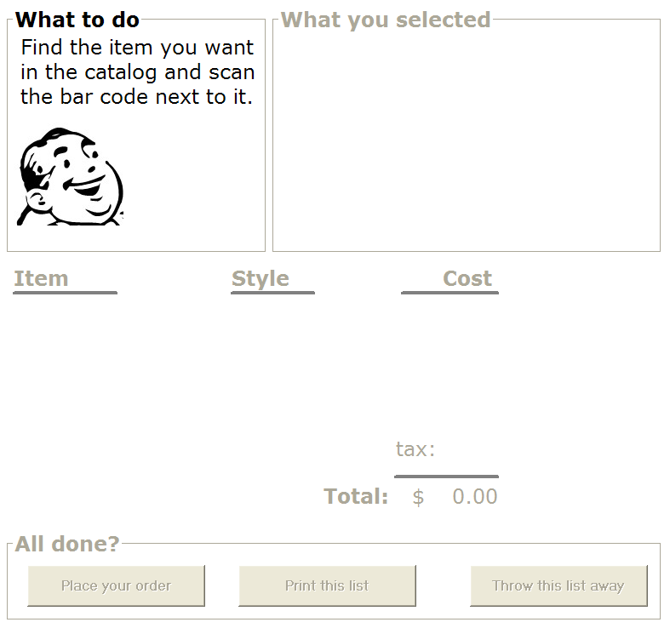


Initial
screen
Scan the
stroller ->
Change the
color ->
Place the
order ->

Slide 30
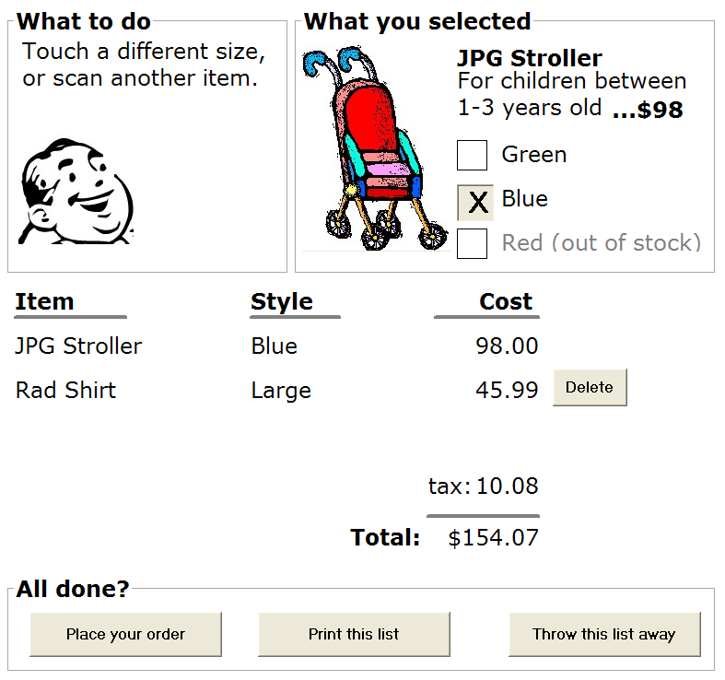
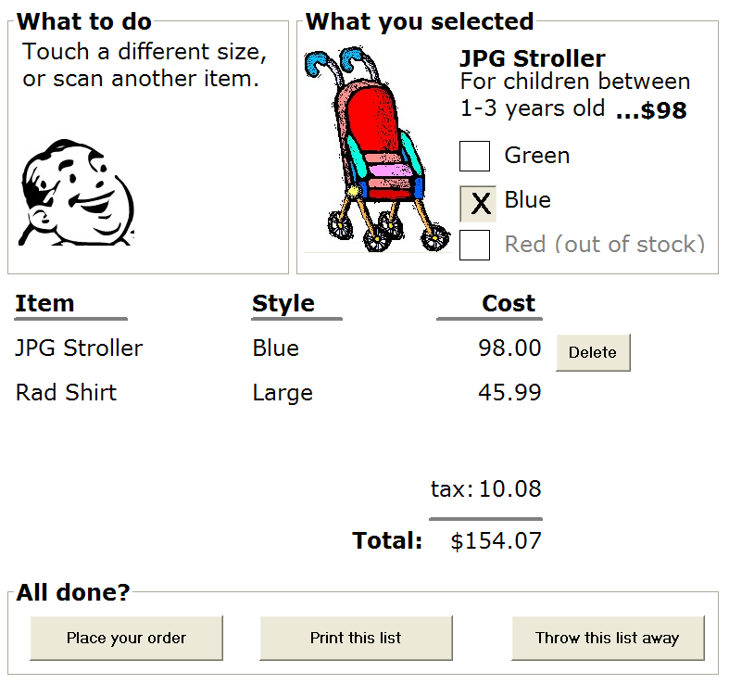
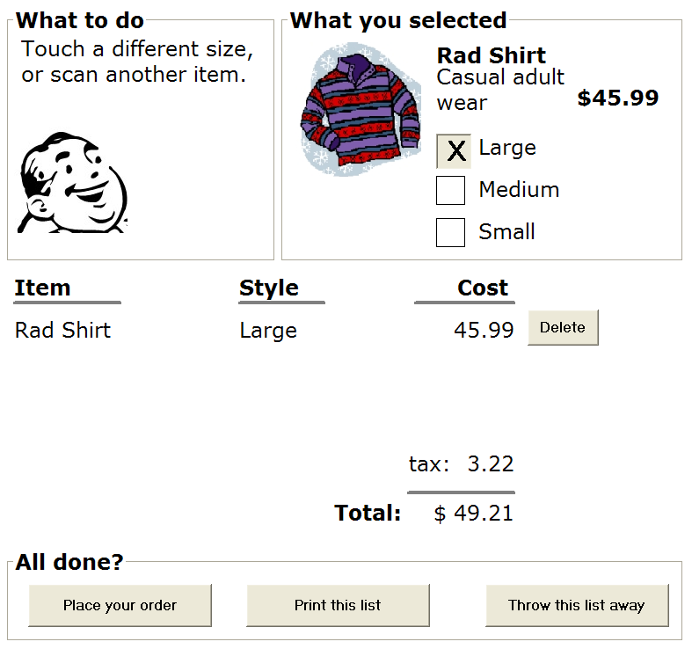
Alternate
path…
Scan the
shirt ->
Touch
previous
item ->
Delete
that item->

Slide 31
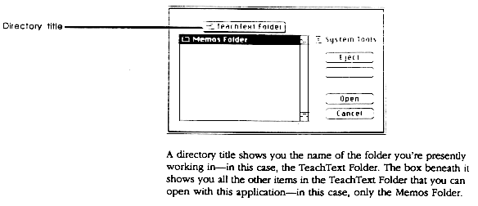
Tutorials as Storyboards
  a step by step storyboard walkthrough with detailed explanations
  written in advance of the system implementation
  also serves as an interface specification for programmers
Apple’s Tutorial Guide to the Macintosh Finder

Slide 32

Pictive plastic interface for collaborative technology initiatives through video exploration
Designing with office supplies
  multiple layers of sticky notes and plastic overlays
  different sized stickies represent icons, menus, windows etc.
interaction demonstrated by manipulating notes
  new interfaces built on the fly
session videotaped for later analysis
  usually end up with mess of paper and plastic!

Slide 33
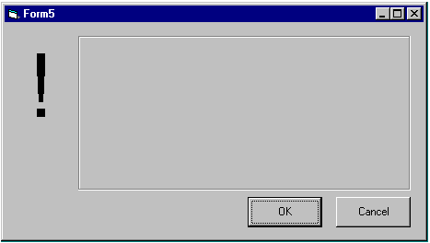

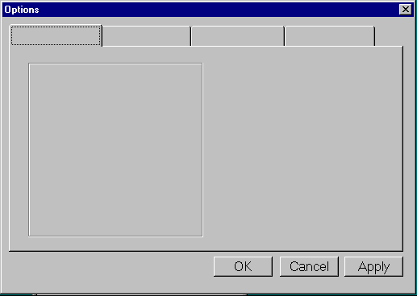
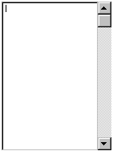
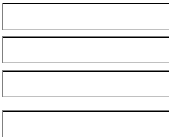
Pictive
Can pre-make paper interface components
buttons
menu
alert
box
combo box
tabs
list box
entries

Slide 34
Paper prototypes
Interactive paper mockup
  sketches of screen appearance
  paper pieces show windows, menus, dialogs
Interaction is natural
  pointing with the finger = mouse click
  writing = typing
A person simulates the computer’s operation
Low fidelity in “look and feel”
High fidelity in depth (person simulated backend)
Fast, easy to change, focus on a big picture,
nonprogrammers can help

Slide 35
Examples
http://www.youtube.com/watch?v=J_mtKPPLi7M
http://www.youtube.com/watch?v=Bq1rkVTZLtU&feature=related
http://www.youtube.com/watch?v=_g4GGtJ8NCY&feature=related
http://www.youtube.com/watch?v=tPau6ihov3E&feature=related
http://www.youtube.com/watch?v=GrV2SZuRPv0
http://www.youtube.com/watch?v=k-9pkB05IlQ&feature=related

Slide 36
What you can learn from paper prototypes
Conceptual model
  does the user have a good one?
Functionality
  does it do what is needed? missing features?
Navigation and task flow
  can users find their way around?
Terminology
  are labels understandable?
Many other usability problems (screen too dense)
Several studies have shown low-fi protos identify sustantially the same usability problems as hi-fi protos!

Slide 37
What you can’t learn
Look: color, font, whitespace etc.
Feel: Fitts’ law issues
Response time
Are small changes noticed?
  e.g., meesages in the status bar, the highlight change, the cursor change
  they are with a paper prototype
Exlopration vs. deliberation
  testers are more deliberate with paper prototypes
  they don’t explore or thrash as much

Slide 38
Medium fidelity prototypes
Prototyping with a computer
  simulate some but not all features of the interface
    engaging for end users
purpose
  provides sophisticated but limited scenario for the user to try
  can test more subtle design issues
dangers
  user’s reactions often “in the small”
  users reluctant to challenge designer
  users reluctant to touch the design
  management may think its real!

Slide 39
Examples
http://www.youtube.com/watch?v=yQ80znZXH7o
http://www.youtube.com/watch?v=kf5hc2vqe4I&NR=1

Slide 40
Limiting prototype functionality
vertical prototypes
  includes in-depth functionality for only a few selected features
  common design ideas can be tested in depth
horizontal prototypes
  the entire surface interface with no underlying functionality
  a simulation; no real work can be performed
scenario
  scripts of particular fixed uses of the system; no deviation allowed
Horizontal prototype
Scenario
Full
interface
Vertical prototype
Nielsen, J. (1993) Usability Engineering, p93-101, Academic Press.

Slide 41
Integrating prototypes and products
throw-away
  prototype only serves to elicit user reaction
  creating prototype must be rapid, otherwise too expensive
incremental
  product built as separate components (modules)
  each component prototyped & tested, then added to the final system
evolutionary
  prototype altered to incorporate design changes
  eventually becomes the final product

Slide 42
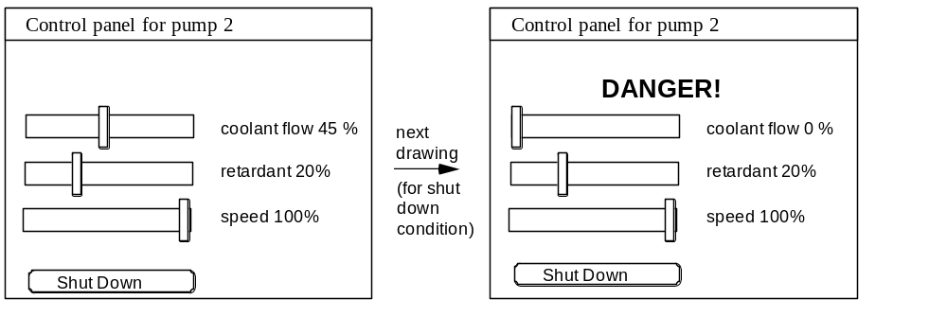
Painting/drawing packages
draw each storyboard scene on computer
  very thin horizontal prototype
  does not capture the interaction “feel”

Slide 43
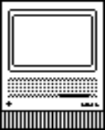
Scripted simulations
create storyboard with media tools
  scene transition activated by simple user inputs
  a simple vertical prototype
user given a very tight script/task to follow
  appears to behave as a real system
  script deviations blow the simulation
Control panel for pump 2
Control panel for pump 2
DANGER!
coolant flow 45 %
coolant flow 0 %
retardant 20%
retardant 20%
speed 100%
speed 100%
Shut Down
Shut Down

Slide 44
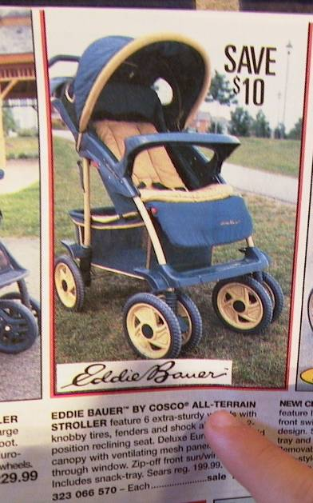

Slide 47


Slide 48
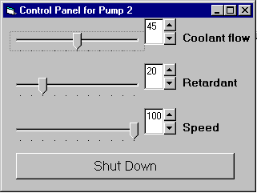
Interface builders
Design tools for laying out common widgets
excellent for showing look and feel
  a broader horizontal prototype
  but constrained to widget library
vertical functionality added selectively
  through programming

Slide 49
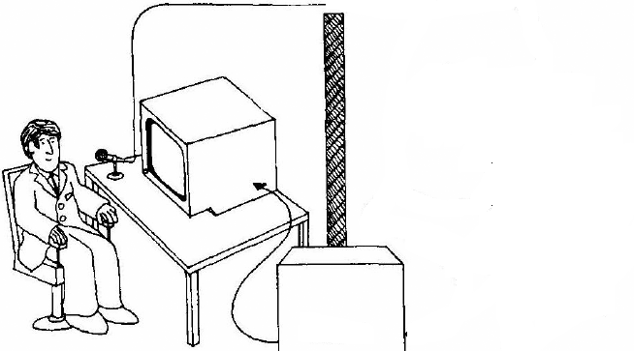
Wizard of Oz
A method of testing a system that does not exist
  the listening typewriter, IBM 1984
Dear Henry
Speech
Computer
What the user sees
From Gould, Conti & Hovanvecz, Comm ACM 26(4) 1983.

Slide 50
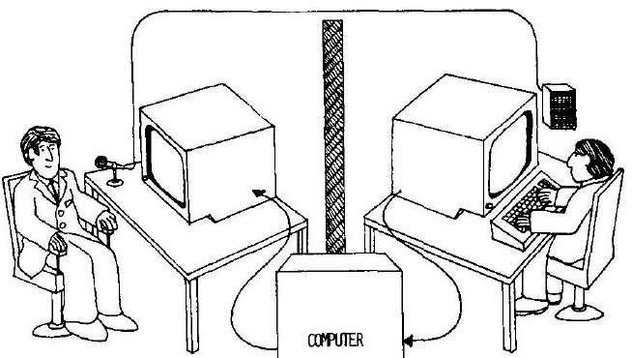
Wizard of Oz
A method of testing a system that does not exist
  the listening typewriter, IBM 1984
Dear Henry
Dear Henry
Speech
Computer
What the user sees
The wizard
From Gould, Conti & Hovanvecz, Comm ACM 26(4) 1983.

Slide 51

Wizard of Oz
Human ‘wizard’ simulates system response
  interprets user input according to an algorithm
  controls computer to simulate appropriate output
  uses real or mock interface
  wizard sometimes visible, sometimes hidden
    “pay no attention to the man behind the curtain!”
good for:
  adding simulated and complex vertical functionality
  testing futuristic ideas

Slide 52
What you now know
User centered + participatory design
  based upon a user’s real needs, tasks, and work context
  bring end-user in as a first class citizen into the design process
Prototyping
  allows users to react to the design and suggest changes
  sketching / low-fidelity vs medium-fidelity
Prototyping methods
  vertical, horizontal and scenario prototyping
  sketches, storyboarding, pictive
  scripted simulations, Wizard of Oz

Slide 53
An interface design process and usability engineering
Articulate:
who users are
their key tasks
Brainstorm designs
Refined designs
Completed designs
Goals:
Task-centered system design
Participatory design
User-centered design
Psychology of everyday
things
User involvement
Representation & metaphors
Graphical screen
design
Interface guidelines
Style
guides
Participatory interaction
Task scenario walk-
through
Evaluate
Usability testing
Heuristic evaluation
Field testing
Methods:
low fidelity prototyping methods
high fidelity prototyping methods
Products:
User and task descriptions
Throw-away paper prototypes
Testable prototypes
Alpha/beta systems or complete specification
Notes:
This diagram captures the major topics in the course and how they fit together as a process defining interface design and usability engineering.
The process goes left to right, where each major block showing the typical things that interface designers have to do. Each block indicates the goals to be accomplished, the methods (or tricks of the trade) that help accomplish those goals, and the products.
In practice, not every step or method is followed. Rather, the interface developer will choose methods appropriate to the time and budget of the project.

Slide 54
Storyboard of a computer telephone
Computer Telephone
Help Screen
Computer Telephone
You can enter either the
Last Name:
Help->
person's name or their
Call by
Last Name: Greenberg
Establishing
First Name:
number. Then hit the
name->
First Name:
connection->
Phone:
place button to call them
Phone:
Place Call
Help
Return
Place Call
Help
Computer Telephone
Computer Telephone
Dialling....
Call
Connected
Call
Last Name: Greenberg
connected...
Last Name: Greenberg
completed...
First Name:
First Name:
Phone:
Cancel
Phone:
Hang up
Place Call
Help
Place Call
Help

Slide 55
Computer Telephone
Help Screen
Computer Telephone
Computer Telephone
Computer Telephone
Computer Telephone
Computer Telephone
You can enter either the
Last Name: Greenberg
person's name or their
Connected
Dialling....
Last Name: Greenberg
Last Name: Greenberg
Last Name:
Last Name:
Last Name:
First Name:
number. Then hit the
First Name:
First Name:
First Name:
First Name:
First Name:
Phone:
Cancel
Hang up
place button to call them
Phone:
Phone:
Phone:
Phone:
Phone:
Place Call
Help
Place Call
Place Call
Place Call
Place Call
Place Call
Help
Help
Help
Help
Return
Help
Help-
Type name and place call

Slide 56
Wizard of Oz Examples
IBM: an imperfect listening typewriter using continuous speech recognition
  secretary trained to:
    understand key words as “commands”
    to type responses on screen as the system would
    manipulating graphic images through gesture and speech
Intelligent Agents / Programming by demonstration
  person trained to mimic “learning agent”
    user provides examples of task they are trying to do
    computer learns from them
  shows how people specify their tasks
In both cases, system very hard to implement, even harder to change!

